Slide 1
EMBEDDED SYSTEM DESIGN LABORATORY - 23I412
MINI PROJECT ON SMART BLIND STICK
23I201- A GESFETHA
23I223- JANANIPRIYA N
23I235- MANOSHREE K P
23I236- MEDULA M

Slide 2
INTRODUCTION
The Smart Blind Stick is an assistive device designed to aid visually impaired individuals in navigating safely.
It uses sensors and automation to detect obstacles and alert the user in real-time.
The project is powered by Raspberry Pi Pico for efficient processing and Wi-Fi-based connectivity.
An integrated Telegram Bot ensures emergency alerts can be sent to caretakers instantly.
The goal is to enhance mobility, independence, and safety — like giving blind users their own high-tech “superpower”

Slide 3
WHY SMART BLIND STICK IS NEEDED?
Over 285 million people globally are visually impaired, with 39 million fully blind.
Traditional white canes do not detect overhead or distant obstacles.
Visually impaired individuals often face risks in navigation, especially in crowded or unknown areas.
Lack of emergency communication tools can delay help in critical situations.
A Smart Blind Stick offers real-time obstacle detection, sound alerts, and emergency messaging for increased independence and safety.

Slide 4
BASIC SYSTEM OVERVIEW
Object Detection: Uses an ultrasonic sensor to detect objects in the user's path.
Alert Mechanism: A buzzer sounds when an object is within a predefined distance.
Movement Assistance: If the object remains stationary for a set time, the servo motor activates to help navigate around it.
Emergency Feature: Pressing the emergency button triggers an alert message to a relative via a Telegram bot.
Wi-Fi Connectivity: The system connects to Wi-Fi for sending emergency alerts and ensuring real-time communication.

Slide 5
Main Components :
Servo Motor Moves based on object detection to assist navigation.
Emergency Button Sends an emergency alert when pressed.
Telegram Bot Sends emergency messages to a predefined contact.
Power Supply Powers the system components.
Raspberry Pi Pico W Controls and processes the entire system.
Ultrasonic Sensor Detects obstacles by measuring distance.
Buzzer Alerts the user with sound when an object is nearby.

Slide 6
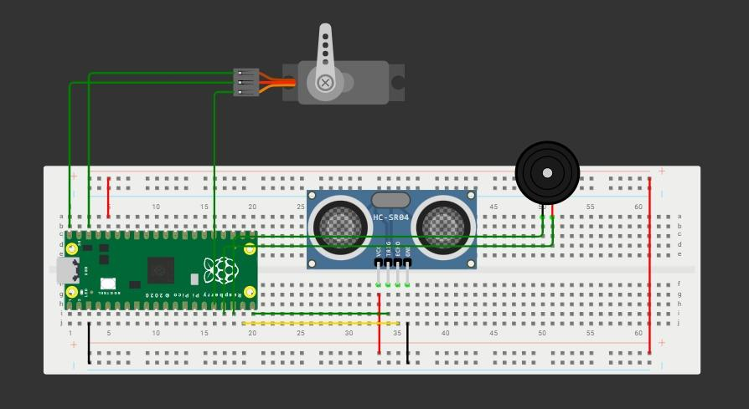
Block Diagram
BLOCK DIAGRAM

Slide 7
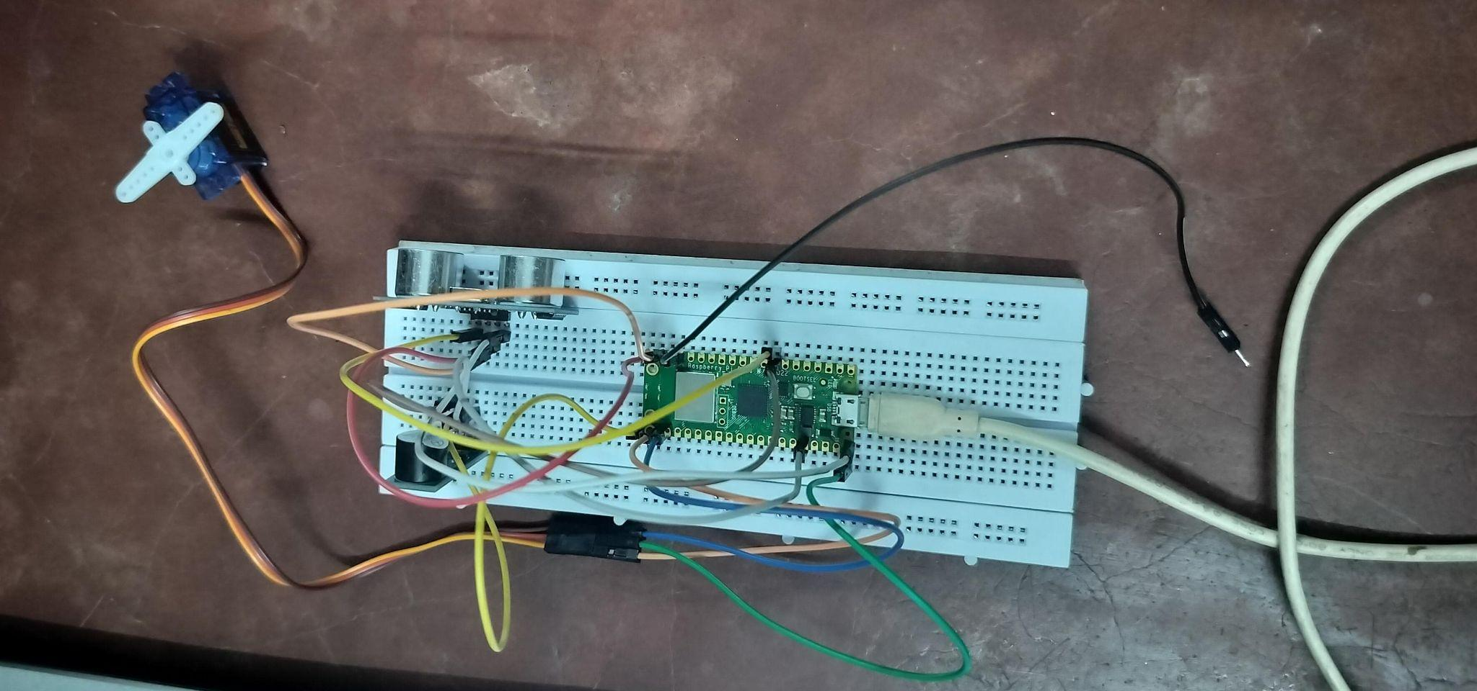

Slide 8
ALGORITHM
Start the system.
Initialize Raspberry Pi Pico W and components (ultrasonic sensor, buzzer, servo motor, Telegram bot).
Continuously monitor distance using the Ultrasonic Sensor.
If distance < fixed threshold:
Activate Buzzer (sound alert).
5. If object remains idle (distance < threshold for a fixed time):
Activate Servo Motor (spin or trigger feedback mechanism).
6. If the user presses the emergency button (jumpers):
Send emergency message via Telegram Bot to a pre-configured contact
7. End the process when the system is shut down.

Slide 9
Code – Setup and Helper Functions
import network, urequests, utime, time
from machine import Pin, PWM, time_pulse_us
# Wi-Fi Credentials
ssid = 'moto g34 5G_2040'
password = 'krishnaprasath'
# Telegram Bot Details
bot_token = 'your_bot_token'
chat_id = 'your_chat_id'
message_text = 'Emergency! The button has been pressed.'
# Pin Setup
button = Pin(13, Pin.IN, Pin.PULL_UP)
TRIG = Pin(15, Pin.OUT)
ECHO = Pin(14, Pin.IN)
buzzer = PWM(Pin(16)); buzzer.freq(1000); buzzer.duty_u16(0)
servo = PWM(Pin(17)); servo.freq(50); servo.duty_u16(1500)
# Wi-Fi Connection
wlan = network.WLAN(network.STA_IF); wlan.active(True)
if not wlan.isconnected():
wlan.connect(ssid, password)
while not wlan.isconnected(): utime.sleep(1)

Slide 10
Code – Setup and Helper Functions
# Helper Functions
def read_distance():
TRIG.low(); time.sleep_us(2)
TRIG.high(); time.sleep_us(10); TRIG.low()
duration = time_pulse_us(ECHO, 1, 30000)
return (duration / 2) / 29.1 if duration > 0 else None
def move_servo():
servo.duty_u16(2500); time.sleep(1); servo.duty_u16(1500)
def send_telegram_alert():
url = f"https://api.telegram.org/bot{bot_token}/sendMessage?chat_id={chat_id}&text={message_text}"
try:
res = urequests.get(url); res.close(); return True
except: return False

Slide 11
Code – Main Logic
# Obstacle Detection
distance = read_distance()
if distance:
print("Distance: {:.2f} cm".format(distance))
if distance < THRESHOLD:
buzzer.duty_u16(32768) # Buzzer ON
if prev_distance and abs(distance - prev_distance) < 0.5:
if still_start is None:
still_start = time.time()
elif time.time() - still_start >= STATIC_WAIT_TIME:
move_servo()
still_start = None
else:
still_start = None
else:
buzzer.duty_u16(0)
still_start = None
else:
buzzer.duty_u16(0)
prev_distance = distance
time.sleep(0.5)
# Variables
THRESHOLD = 30
STATIC_WAIT_TIME = 3
message_sent = False
prev_distance = None
still_start = None
# Emergency Button Handling
while True:
if not button.value():
if not message_sent:
if send_telegram_alert():
message_sent = True
utime.sleep(0.5)
else:
message_sent = False

Slide 12
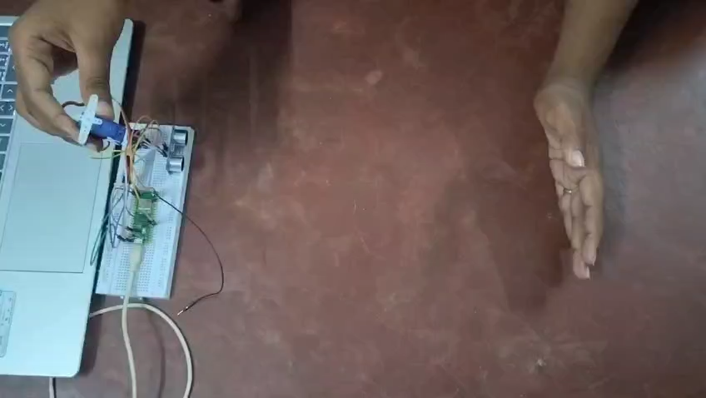
OUTPUT

Slide 13
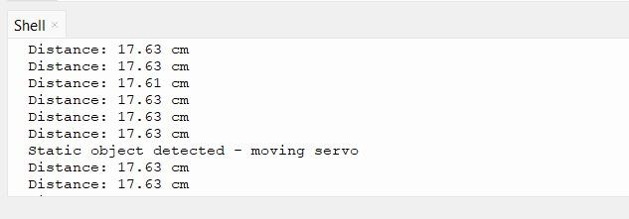
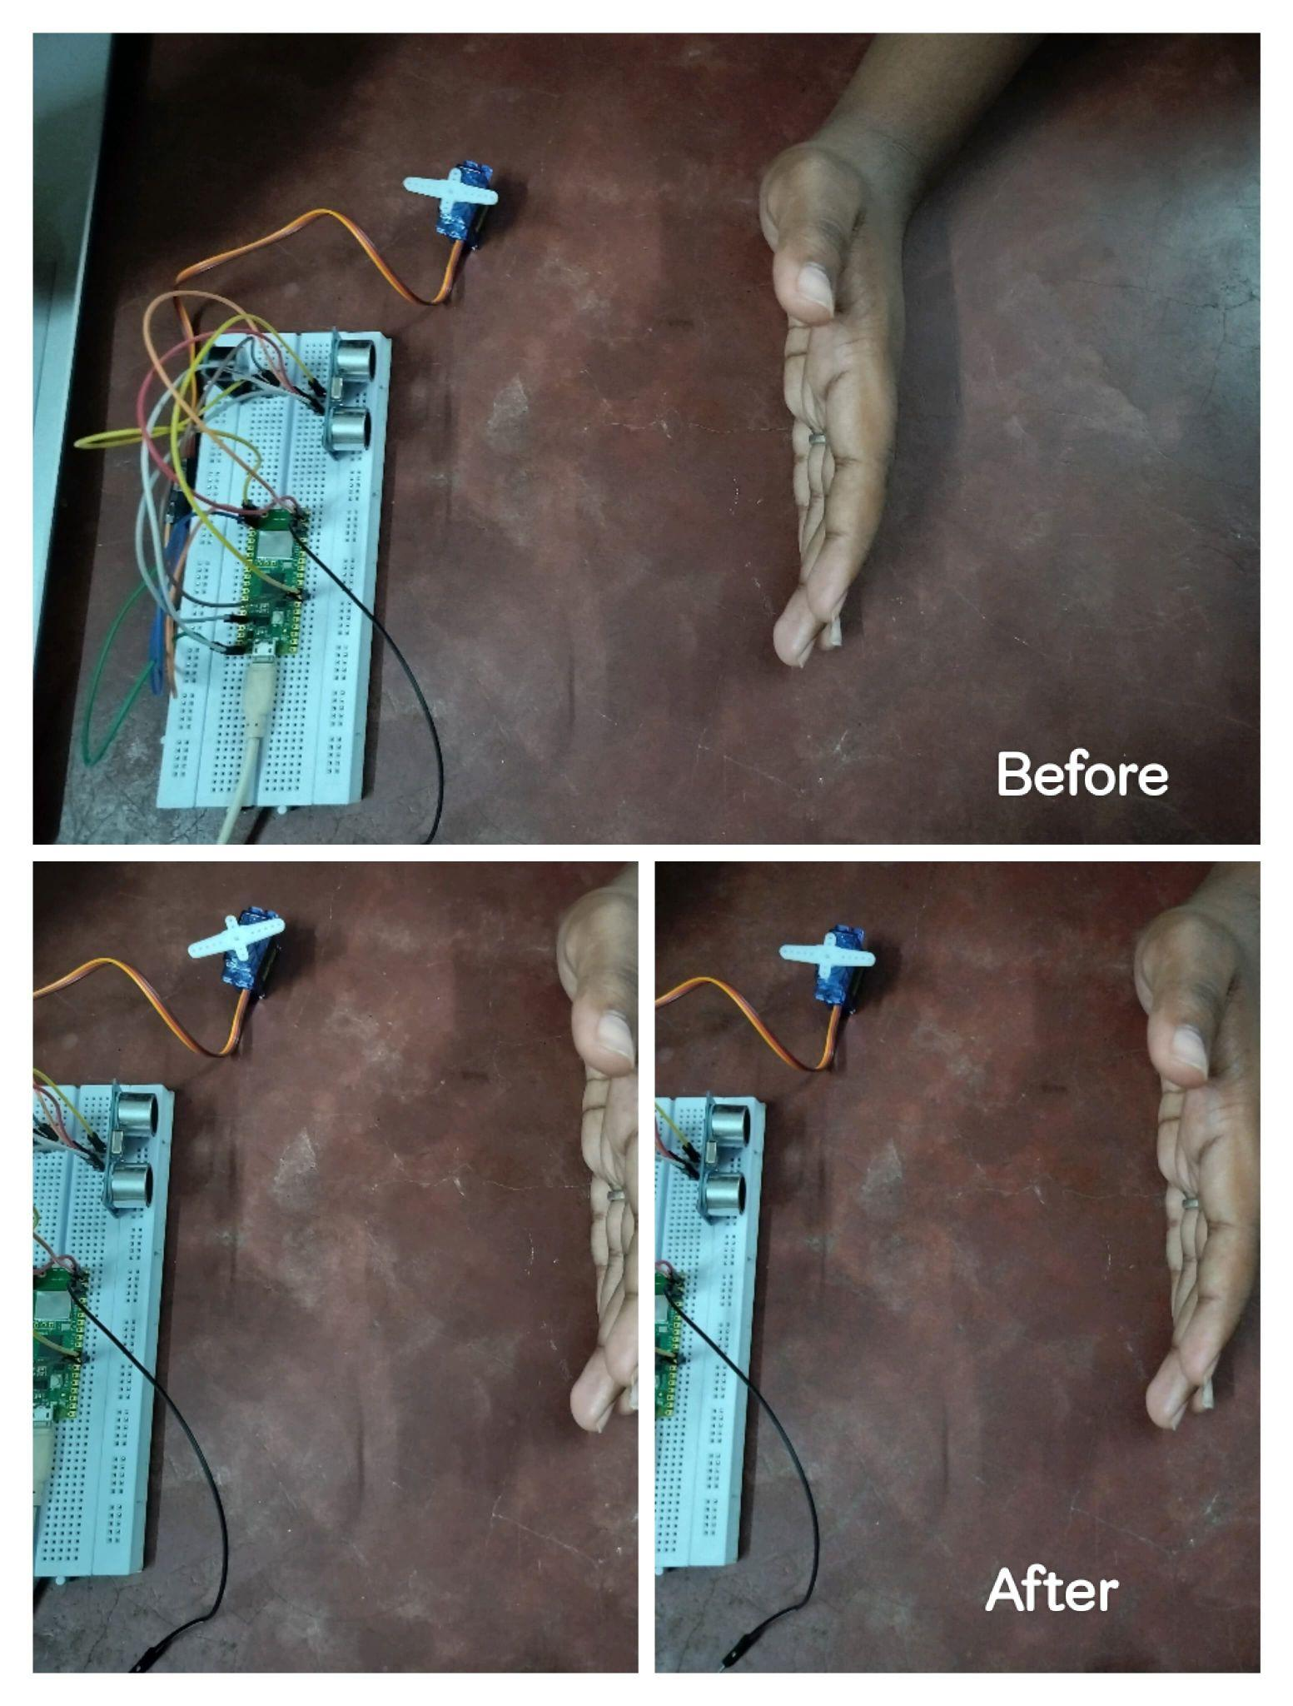

Slide 14
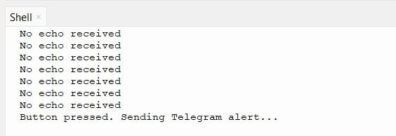
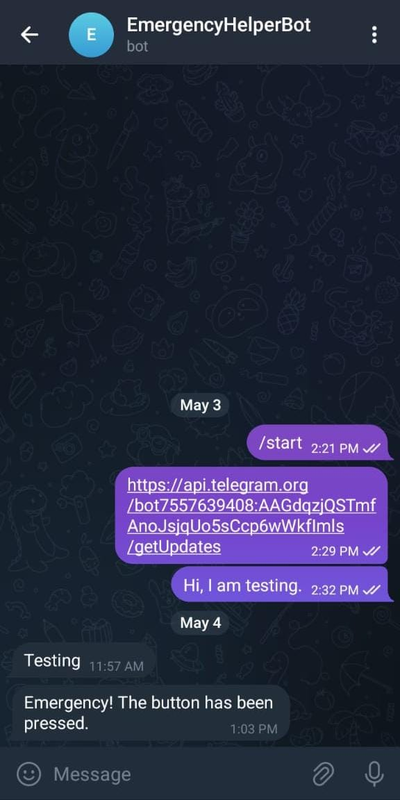

Slide 15
RESULT
Real-Time Obstacle Detection
– Accurately detects static obstacles within 30 cm using an ultrasonic sensor.
Emergency Alert System
– Sends an instant Telegram message when the emergency button is pressed.
Auto-Servo Movement
– Servo motor activates automatically for static object removal.
Audible Warning
– Buzzer alerts when any object comes too close.
Smart Monitoring
– Differentiates between moving and static obstacles using distance change logic.

Slide 16
APPLICATIONS
Assistance for Visually Impaired – Helps users detect obstacles and navigate safely.
Elderly Care – Provides support for elderly people with limited mobility or vision.
Smart Navigation – Can be used in smart cities or public spaces for easier navigation.
Indoor Navigation – Useful in malls, airports, or offices to avoid collisions.
Emergency Alert System – Quickly notifies family members in case of an emergency.

Slide 17
FUTURE SCOPE OF SMART BLIND STICK
Integration with GPS: Voice-guided navigation
IoT Connectivity: Track location, send alerts to guardians
Water/Pit Detection: Enhance safety in rainy conditions
Mobile App: Customize alert levels, real-time map view
AI & ML Integration: Recognize environments and guide intelligently

Slide 18
CONCLUSION
In conclusion, our project effectively integrates sensor technology, wireless communication, and automation to detect obstacles and respond to emergencies. The ultrasonic sensor measures distance and activates the buzzer and servo motor when a static object is detected. In urgent situations, the emergency button triggers a Telegram alert, ensuring immediate notification. With a simple yet powerful design, the system enhances safety and can be applied in environments like smart homes, healthcare, and security systems. The overall implementation proves to be efficient, reliable, and scalable for real-world use.

Slide 19
THANK YOU

